Slide 1

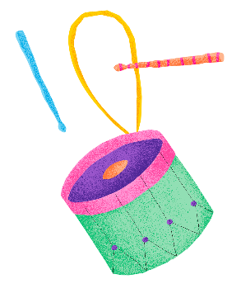
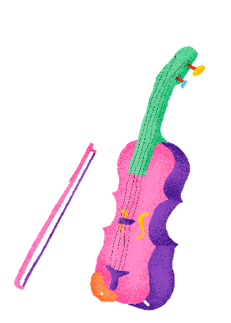
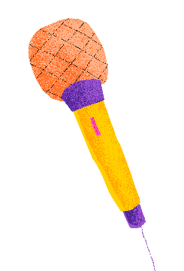
Mental Health Awareness Week
1
Looking after our mental health:
Music for self-care

Slide 2



2
What will we learn today?
The difference between physical and mental health.
Some ideas of things you can do if you feel lonely, sad or worried.
How some people use music to be more mentally healthy.

Slide 3

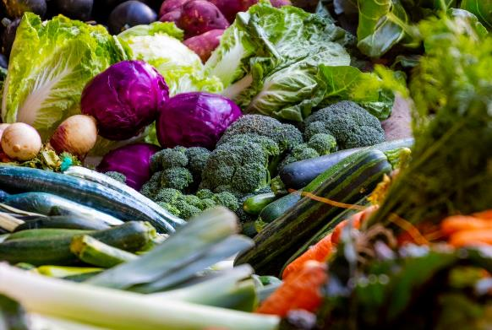
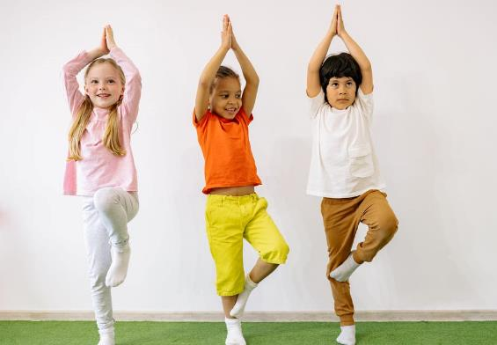
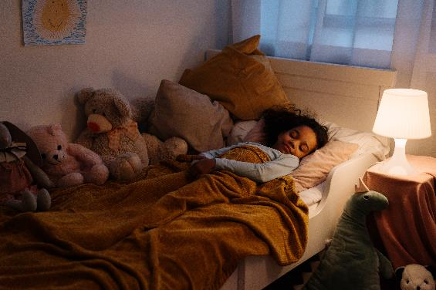
3
What is physical health?

Slide 4

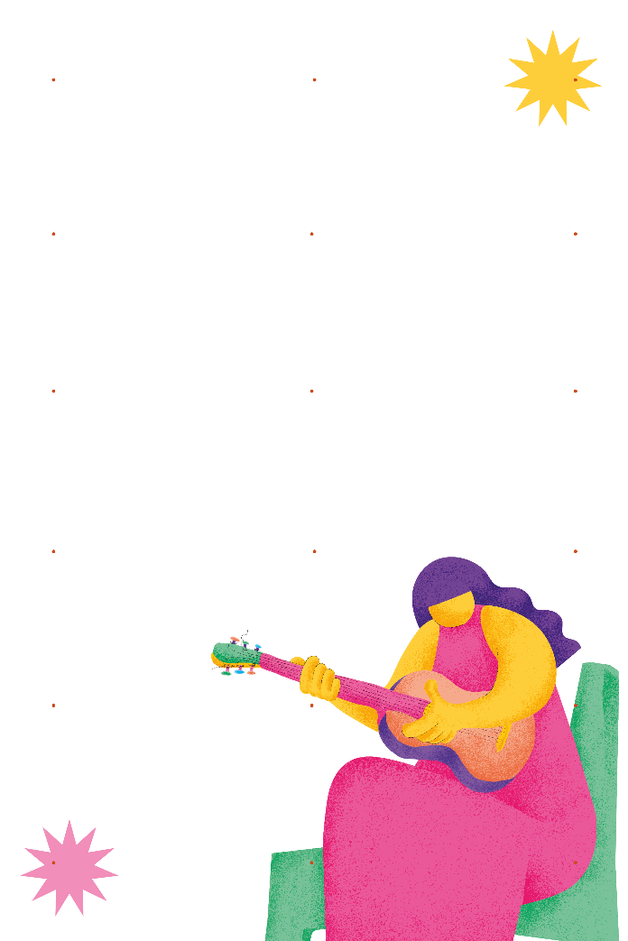
Mental health is about our feelings, our thinking, our emotions and our moods.
4

Slide 5

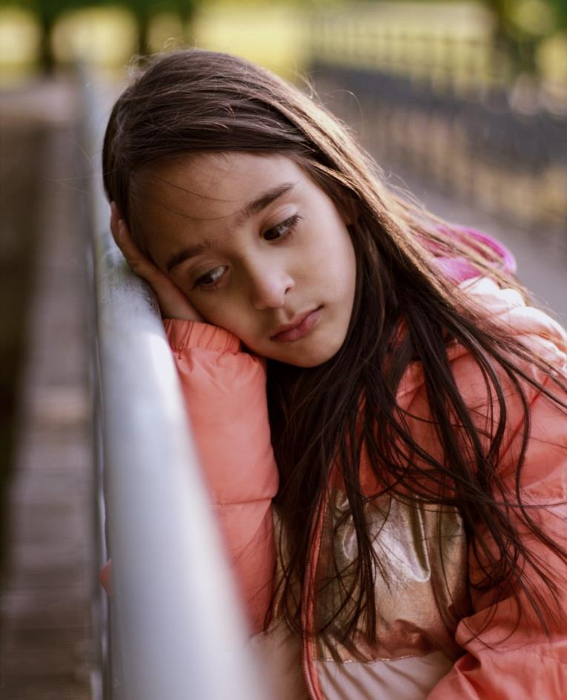
5

Slide 6

6

Slide 7
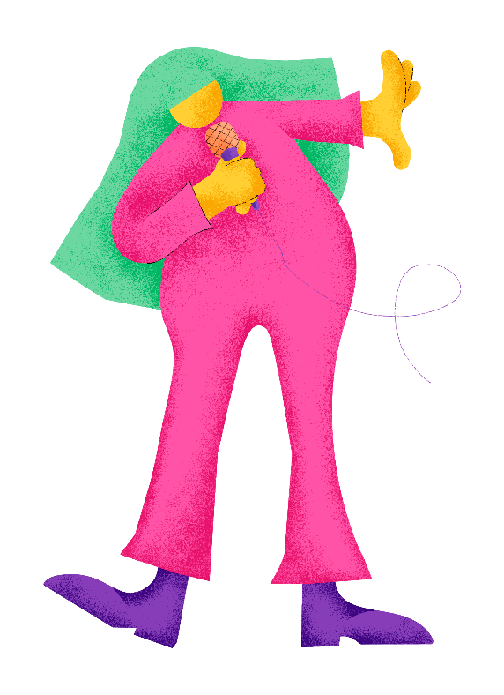
Being alone is not the same as being lonely
7
“When I’m by myself, I can sing my favourite songs”

Slide 8



8
Sometimes feelings make sense
Forgotten PE kit
Excited
A friend's birthday party
Frustrated
Rainy lunch-time
Worried

Slide 9



9
But sometimes we experience feelings that we can’t explain
Spending time with friends
Lonely
Stressed
Watching a film
Playing sports
Confused

Slide 10
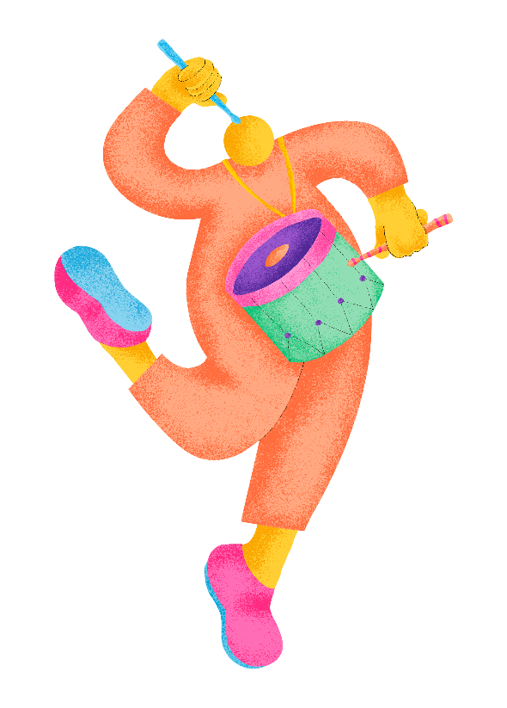
What things can you do on your own to feel mentally healthy?
10
Playing a musical instrument
Exercising
Reading a book or comic
Drawing and painting

Slide 11
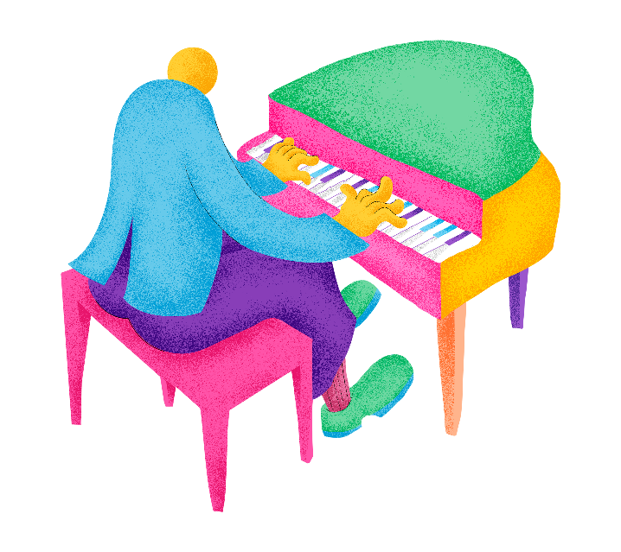
11
“The sound of the piano makes me feel calm and peaceful”

Slide 12

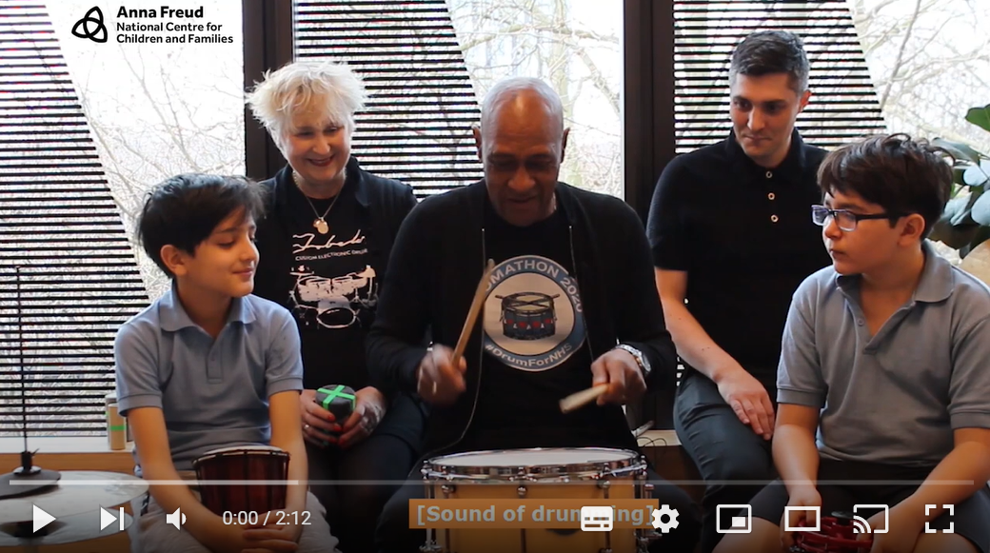
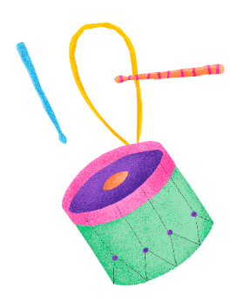
Drumming and self-care
12
Watch video here

Slide 13
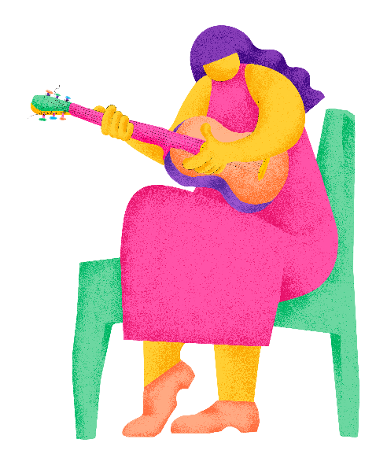
What could you do if you notice a friend looks lonely in the playground?
13
What things can you do if you are feeling sad?

Slide 14
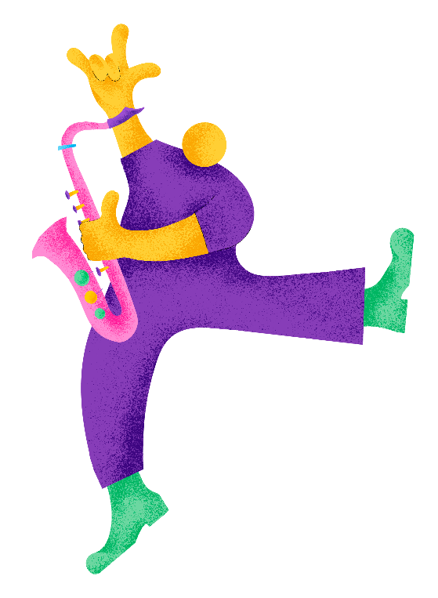
Who can help?
14
“If I feel really lonely or worried, I can speak to a friend or let a trusted adult know”
Teachers
School Nurse Lesley

Slide 15



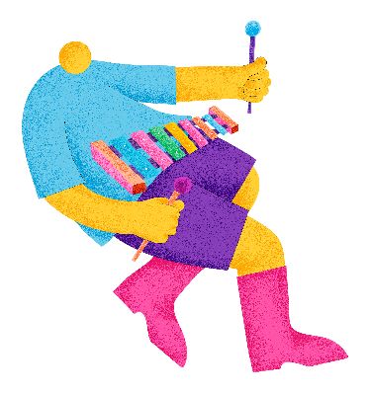
15
Remember that we all have mental health…
… and even if we are sometimes feeling lonely it doesn’t mean that we are alone.

