Slide 1

PHYSICAL MOVEMENT & INCLUSIVE PRACTICE
At St Columba’s Catholic Primary School

Slide 2
About Our Specialist
Karen Griffiths.
I am passionate about delivering/promoting physical movement inclusive practice in all educational settings.
Working with children who have specific needs
Previous Roles
Specialist Advisory Teacher for Autism, working across the infant, primary and secondary mainstream settings.
Head of Physical Education.
Tailored, practical hands-on support and interventions (l
My aim is to work closely with and upskill staff within the school setting, so that in the future, staff will themselves become proficient in delivering the programmes.

Slide 3
The Offer
Early Years Motor Screening Programme.
Sensory motor circuits.
Buddy Clubs.
Neurodiverse P.E lessons.
Sensory break cards.

Slide 4
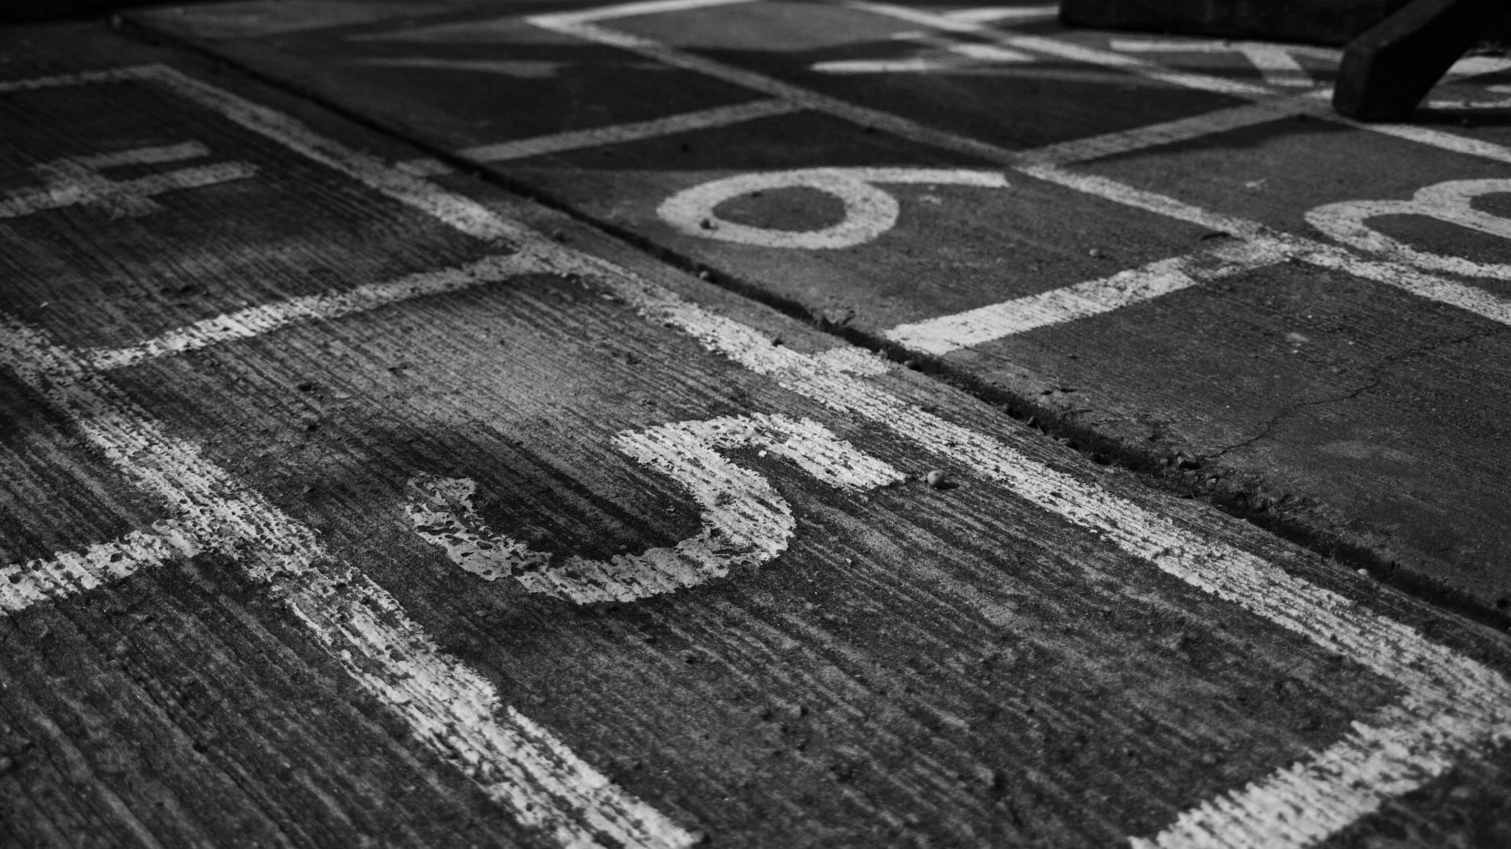
Early Years Motor Screening Programme

Slide 5
Early Years Foundation stage Motor Screening was developed by Dr Vanessa King and Dr Kirsty Howells during 2023-2024 in conjunction with the Association for Physical Education.
The idea behind the programme is to create new neural connections in the brain and body developing; Balance; Coordination; Agility; Core Strength; Postural Control; Hand Eye Coordination & Suppression of primitive reflexes.
Notes:
Based upon an initial programme developed in 2015 by medical and educational professionals in the Solent NHS Trust.
In 2023 22,556 children were waiting to access Occupational Therapists. Lack of motor competence may not need clinical intervention but children need exposure to the correct movements which is where the programme comes in.
The new programme includes the integration of primitive reflexes alongside the development of motor competency.
It is hoped that it will be rolled out nationally as there are currently no national motor competency screening and intervention programmes in the uk.
A lot of NHS referrals are due to lack of enriching environments in infancy.
Repetition of movements strengthens neural pathways for life.
First 5 years are key to rapid brain development.

Slide 6
Where my work will be focused .
Notes:
In order for the top part of the pyramid to be optimal for each child they need to have all of the other layers of the pyramid to help attention and focus.
When building a house, you cannot to start to put the windows in if your foundations are only half completed.
Neurodiverse children have less integrated primitive reflexes.
Can’s start with motor development if the other two systems are not developed.

Slide 7
How the programme will work
Conduct “Identifying Functional Skills” Screening.
Assign Children to 3 groups: A, B or C
Children to take part in 15 to 20 mins of their group exercises X 3 per week.
Repeat screening after 4-6 weeks and move children into new groups if needed.
When children have mastered all of the exercises in groups A, B & C they are deemed to be motor competent.
Notes:
Working initially with year 1 and then reception from April to get them ready for Year 1.

Slide 8
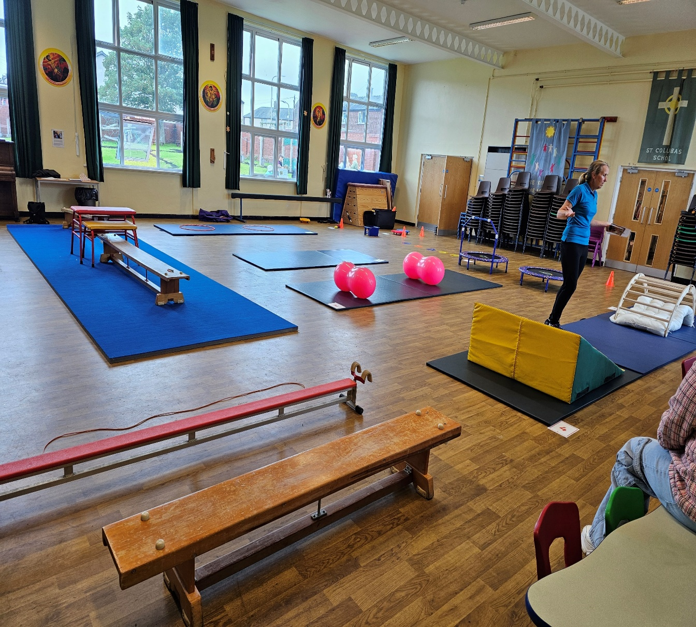
Sensory Motor Circuits

Slide 9
Sensory Motor Circuits aimed primarily at reception and Year 1&2 pupils, but any pupil who has underdeveloped sensory motor systems will benefit from participating in the circuits.
.

Slide 10
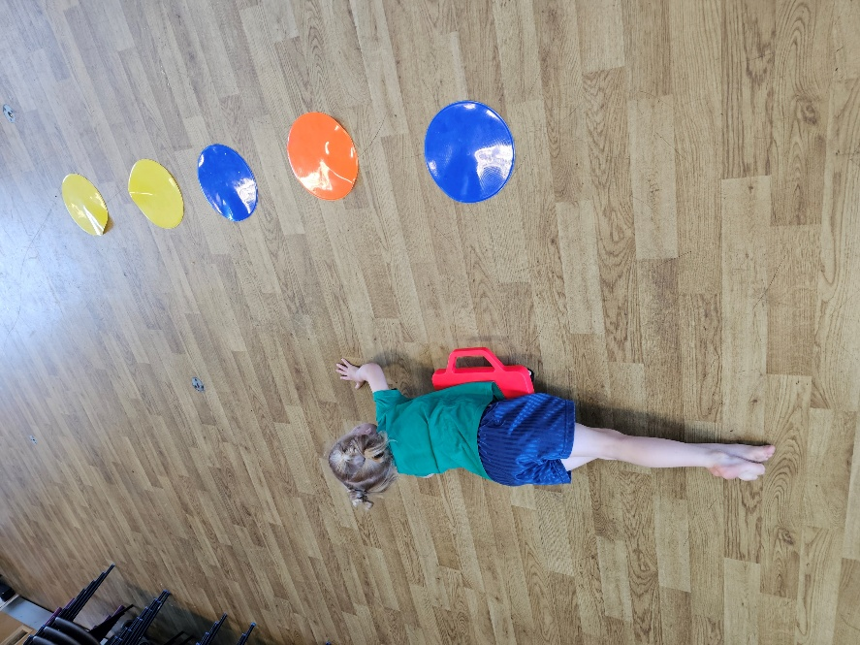
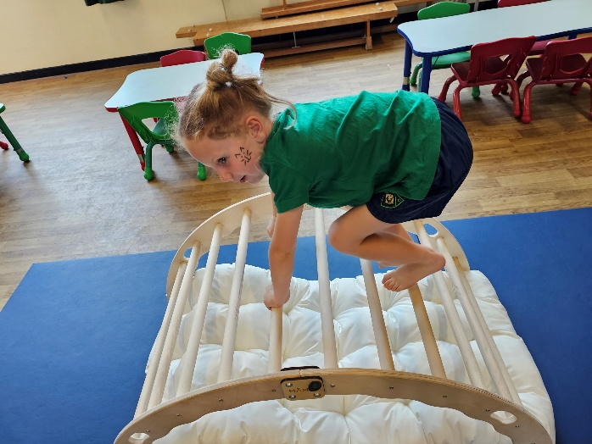
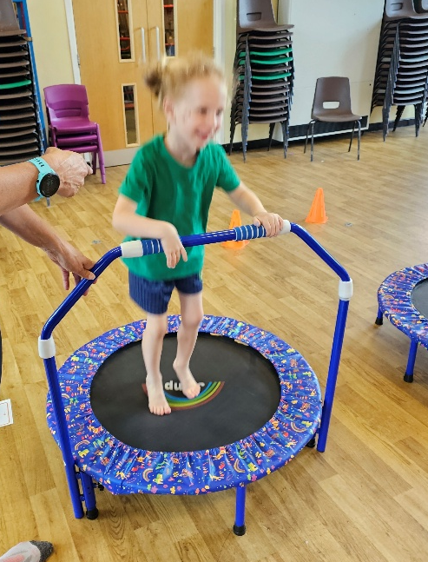
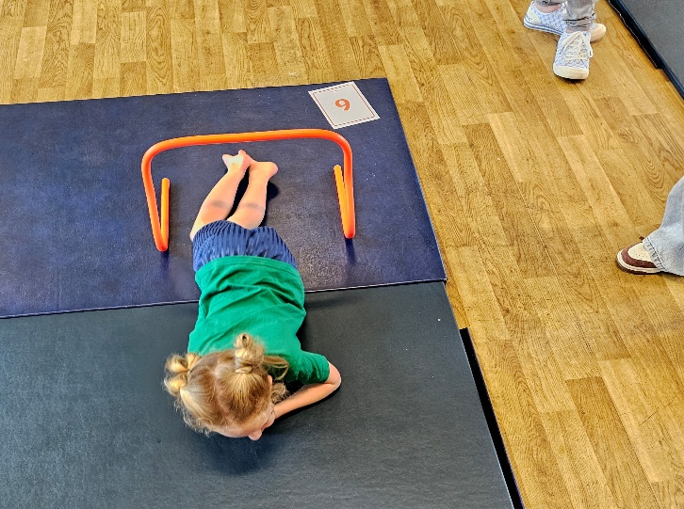
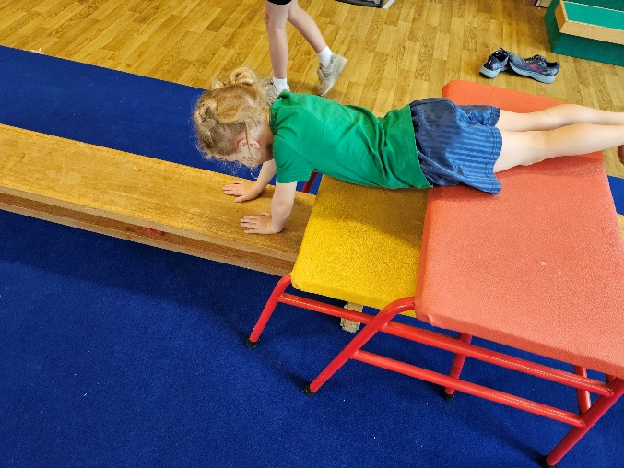
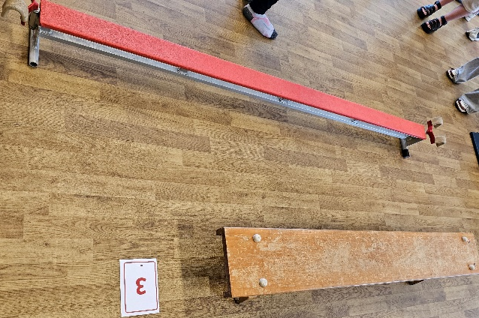
Activities focus on developing the vestibular systems (core strength and gravitational security) the proprioceptive system (fluidity of movement & creating a body map) alongside balance and coordination.
Notes:
The stronger the connection with the vestibular system the better the listening and concentration skills (same part of the body processing sound –inner ear).
Lack of core strength impacts on learning – Difficulties concentrating, struggling to sit up on the carpet or at a desk, difficulties holding the correct position to read and write, This can then impact on learning and lead to disruptive behaviours.

Slide 11
The circuit will be set up and run by myself and the Teaching Assistants that support the pupils within the group, for 20 to 30 mins, on a weekly basis. Ideally the pupils should be able to access the circuit on at least 2 other occasions in the week.

Slide 12
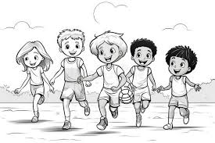
Buddy Clubs

Slide 13
Lunch Time Buddy Club
Aimed at children with SEND who struggle to navigate unstructured times.
Classroom based.
Supported by year 5 Leaders.
After School Sports Buddy Club
Aimed at pupils in years 3 to 6 who have SEND or who may be lacking in confidence, self esteem, social skills, movement difficulties whom it is felt would benefit from being involved in an extra curricular club.
Maximum of 8 buddies and 8 leaders at anyone time. Sessions will be tailored to the individual needs of each pupil.
The club will be run by myself with help from Charlotte Plant and Year 6 Leaders.

Slide 14
Neurodiverse Physical Education Lessons

Slide 15
Research informed Physical Education sessions for pupils who are neurodiverse.
The sessions will be small group 1 x 1 hr per week.
Sessions will be highly differentiated and structured so that they are fun, inclusive, targeted and maximise the potential for positive outcomes for all involved.
Notes:
The research from my master's dissertation which focused on the effects of exercise on cognition and learning for young people who are neurodiverse will be used to create the sessions (more information on the research can be provided upon request).
Focus on specifics such as winning and losing, working as a pair, a group and a team. Developing resilience etc

Slide 16
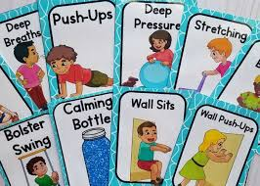
Sensory Break Cards

Slide 17
Sensory Break Cards
Aimed at Pupils who have sensory differences and who benefit from having sensory breaks from their learning.
Information will be gleaned from external professionals, school staff, parents and where applicable the pupil themselves to identify each pupil's specific sensory needs
Sensory Break Cards will be produced working in conjunction with the pupil and those that support them.
Notes:
The sensory break card will be shared with parents and all those within school who work with the pupil.
Give rationale behind why creating Sensory Break Cards.
Show example of sensory break card.
The sensory break cards will be reviewed on a Termly bases and any changes made at this stage.

Slide 18
Every day to support learning
Daily Mile

