Slide 1
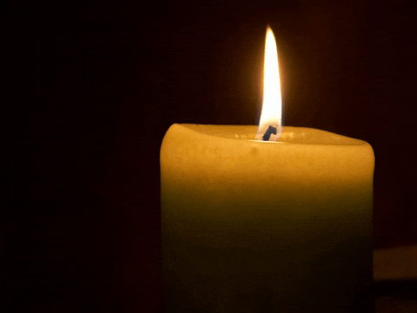
“For I was hungry and you gave me food, I was thirsty and you gave me something to drink, I was a stranger and you welcomed me…” Matthew 25:35
Notes:
Opening prayer-Jacqueline

Slide 2

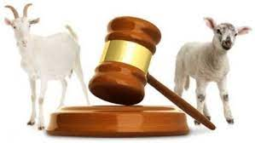

Christ the King
Gather:- As we gather look at the images. In silence think about the images. What do you see? Let us make the sign of the cross.
Sunday is the feast of Christ the King we hear a story Jesus told to his disciples and friends.
Listen:- When the Son of Man comes in glory with all the angels, he will sit on the throne and be the king of the whole world. All the people in the world will be gathered in front of him, and he will sort the people into two groups just like a shepherd sorts the sheep from the goats. To the people on his right he says…
“For I was hungry and you gave me food, I was thirsty and you gave me something to drink, I was a stranger and you welcomed me…,Then the righteous will answer him, ‘Lord, when was it that we saw you hungry and gave you food, or thirsty and gave you something to drink? And when was it that we saw you a stranger and welcomed you… and the king will answer them, ‘Truly I tell you, just as you did it to one of the least of these who are members of my family, you did it to me.’ ” Matthew 25:31-46
John 10:10 “I have come that they may have life and hav it to the full”

Slide 3
Christ the King
Respond:- Dear God, make us generous and loving so that we will always help people in need the way Jesus told us to. Help us remember that when we see people in need, we are also seeing and helping you, Jesus. Amen.
Go Forth: Look for ways that we can help others around us, and in so doing, remember that we are also helping God. We can continue to do this through all of our groups.
Thank you to all our groups, you are truly doing what Jesus asks us to do and you should be very proud of your commitment and the work you do.
Mini Vinnies
Laudato Si
Legion of Mary
Justice Group
Prayer Leaders
John 10:10 “I have come that they may have life and hav it to the full”

Slide 4
“‘Truly I tell you, just as you did not do it to one of the least of these, you did not do it to me.”
Notes:
Opening prayer-Jacqueline

Slide 5
Christ the King
Gather:- As we gather, let us make the sign of the cross. Yesterday, we heard the first part of Jesus’ parable of the Sheep and the goats, what did those on the left do? Let’s find out, listen to the rest of the parable. As you listen think about the carefully. What didn’t they understand?
Listen:- “For I was hungry and you gave me no food, I was thirsty and you gave me nothing to drink, I was a stranger and you did not welcome me, naked and you did not give me clothing, sick and in prison and you did not visit me.’ Then they also will answer, ‘Lord, when was it that we saw you hungry or thirsty or a stranger or naked or sick or in prison, and did not take care of you?’ Then he will answer them, ‘Truly I tell you, just as you did not do it to one of the least of these, you did not do it to me.’
If they knew it was Jesus they would have helped? What does this tell us about these people?
John 10:10 “I have come that they may have life and have it to the full”

Slide 6
Christ the King
Respond:- Let us pray, Jesus, our shepherd, we are pleased to be called your sheep because we love you and want to follow your ways. Help us to be kind and loving to anyone in need – the poor, the hungry, the sad, the lonely, and those who are in prison or are sick – just like you showed us when you were on earth. Help us to show love for others as you show love for us. Amen
Go Forth:- Remember to help everyone, and continue your good work in your groups as we put our faith into action and show love of God through our love and care of others. We remember that all your children are the same and are all deserving of help.
John 10:10 “I have come that they may have life and have it to the full”

Slide 7
“Be alert, stand firm in the faith, be brave, be strong. Do all your work in love.” 1 Corinthians 16:10-11
Notes:
Opening prayer-Jacqueline

Slide 8


Slide 9

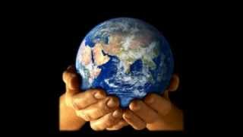
Red Wednesday
Gather:- As we gather, we think of all of the people who are not free to pray or go to church and are persecuted for their faith. We light a candle to remember all of these people and hope that they feel your light and love. Today, is Red Wednesday is a day we think if Christians in the world whose expression of faith puts them in DANGER
Listen:- “Be alert, stand firm in the faith, be brave, be strong. Do all your work in love.” 1 Corinthians 16:10-11
Respond:- Listen to the prayer of St. Teresa of Avila (click on video link)
John 10:10 “I have come that they may have life and have it to the full”

Slide 10
Red Wednesday
Respond:-Loving Father, As we prepare to think about Red Wednesday, guide our hands to carry out your work on earth. May our hands be ones of prayer and giving, of touching and healing, of welcome and invitation. Amen.
Go Forth:- Stand up. Speak out and break the silence.
Could you go to Mass for someone who is unable to? Make a red sticker to remember all the people who are unable to go to Mass.
John 10:10 “I have come that they may have life and have it to the full”

Slide 11
“For the Son of Man came not to be served but to serve, and to give his life a ransom for many.” Mark 10:35
Notes:
Opening prayer-Jacqueline

Slide 12
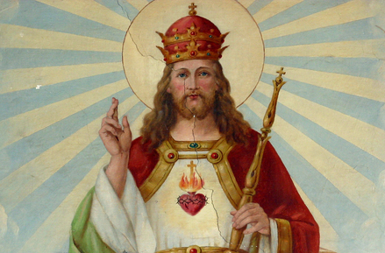
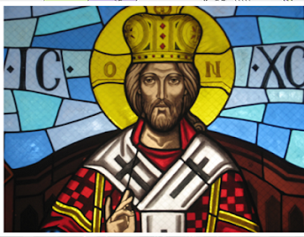
Christ the King
Gather:- When you think of a King? What do you think of? A person who is rich and powerful?
On Sunday, we celebrate the king of all kings. Jesus is a king, but a different kind of king than we're used to. He isn't a king with a gold and jewel crown, who has riches and jewels and servants, and who orders people and armies around. Jesus is a king, but the best kind of king. He is the King of Heaven (where he promises to take us), the King of Love (which he offers to us freely), the King of Sacrifice, who takes all of our sins and the things we do wrong, and He wipes them away. Jesus doesn't want to be king of countries and armies, He wants to be the King of our hearts and our lives. He is the most wonderful King, the best kind of King, a King who wants to give us forgiveness, love, heaven, and eternal life with Him!
Listen:- “For the Son of Man came not to be served but to serve, and to give his life a ransom for many.” Mark 10:35
Respond:- Dear God, thank you for being the kind of King who doesn't want gold and power and treasure, but a King who wants our hearts and love. Thank you for being a King who wants to give everything that is good to his people, and to us, his children. Amen
Go Forth:- Be thankful for Jesus and what he is ready and willing to offer us. Show this love to others. Make Jesus a crown. On this crown draw and write Jesus’s special qualities that make Him the best ever king.
John 10:10 “I have come that they may have life and have it to the full”

